Slide 1
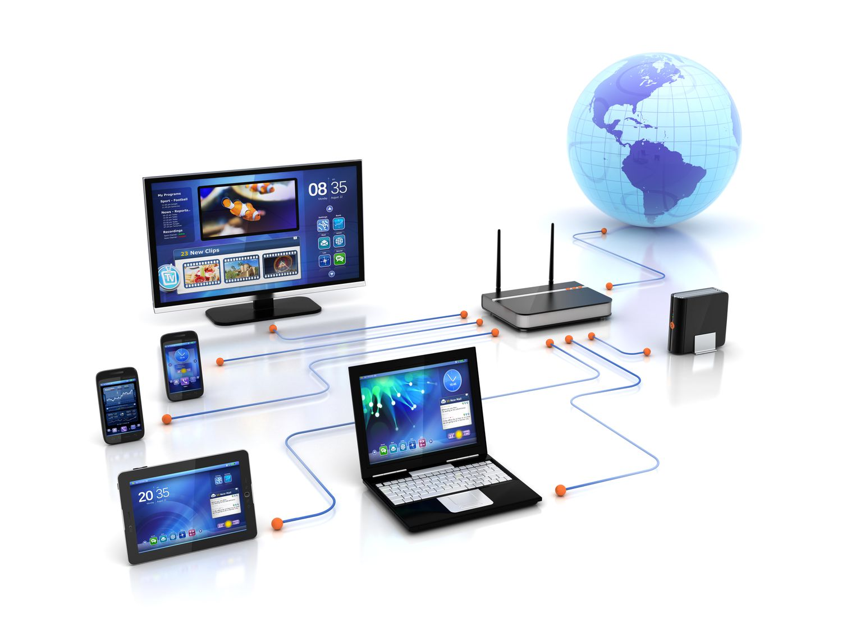
COMPUTER NETWORKS
Chamindu Kasun Karunarathna
BSc (Hons) in Information Technology

Slide 2
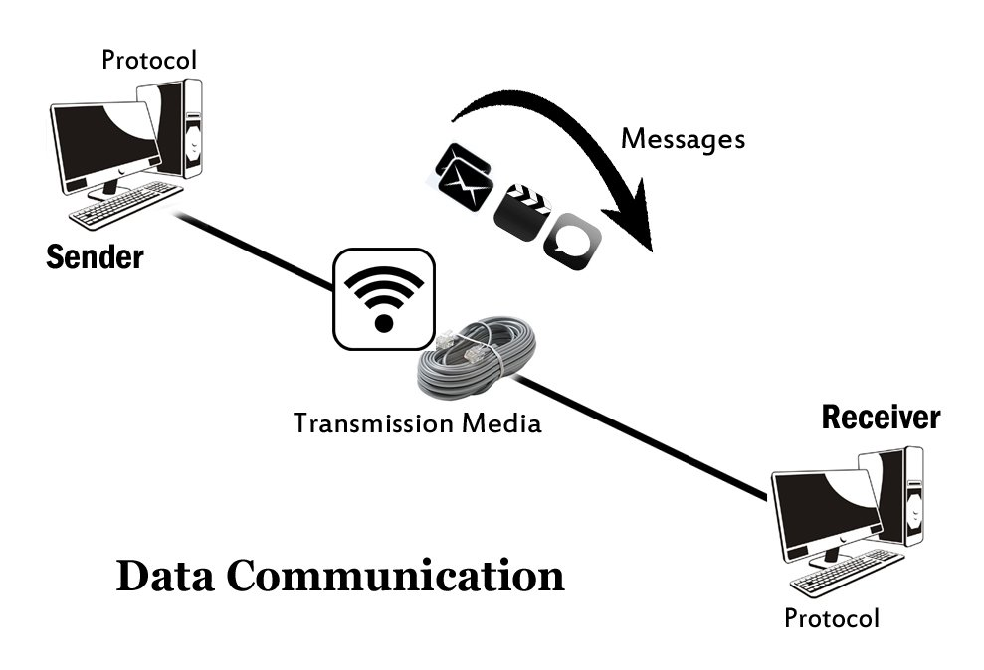
What is Data Communication?
Data Communication is the exchange of data (information) between two or more communication devices (like computers, phones, sensors) over a communication medium.

Slide 3
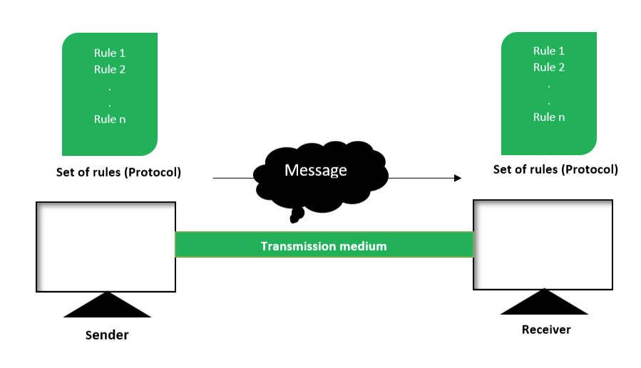
Components of Data Communication System

Slide 4
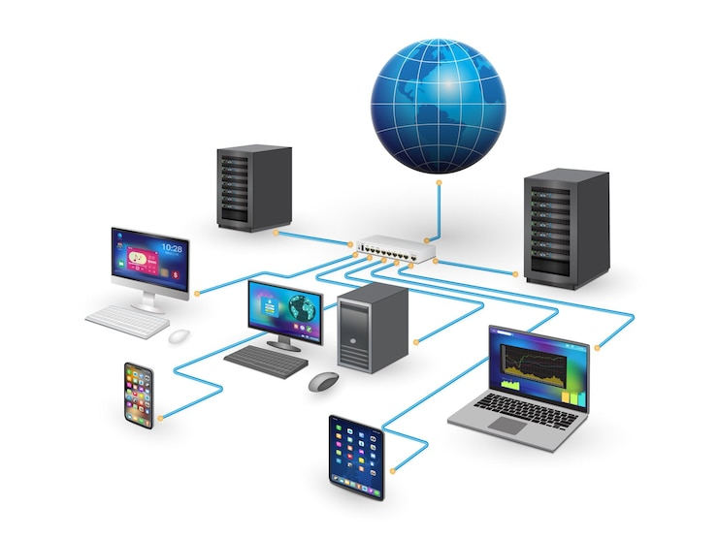
What is a Computer Network?
A computer network is a system of interconnected computing devices that can exchange data and share resources

Slide 5
Components of Data Communication System

Slide 6
The Bit
Computers and networks only work with binary digits.
Computers use binary codes to represent and interpret letters, numbers and special characters with bits.
Capital letter: A = 01000001
Number: 9 = 00111001
Special character: # = 00100011
Each group of eight bits, such as the representations of letters and numbers, is known as a byte.

Slide 7
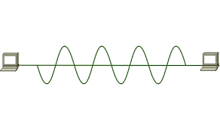
Signals
Bits are just abstract values. To send them from one device to another, we need to turn them into something that can physically travel.
A signal is a physical representation of a bit that can travel through a medium (like a wire or air).
At the receiver’s end:
Signals are converted back into bits, then interpreted as data.

Slide 8
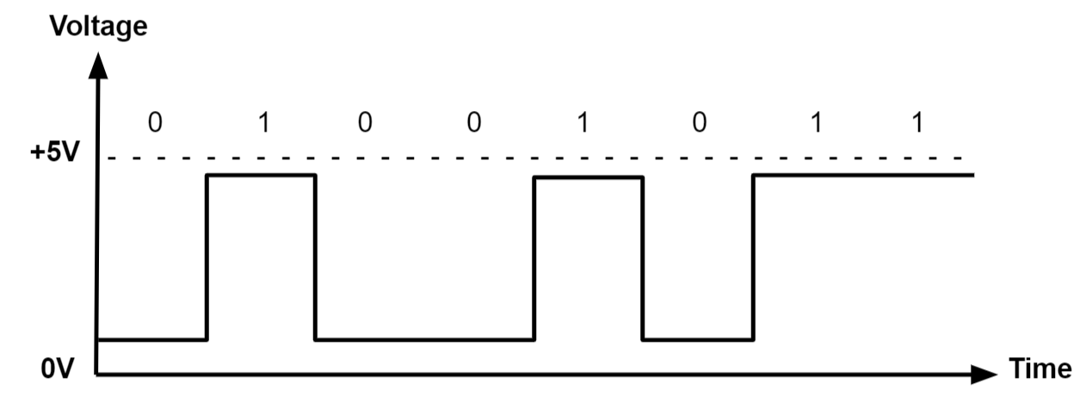
Digital Signals
Digital signals are discrete in value and time. These signals are represented by binary numbers and consist of different voltage values.
Digital signals are used in all digital electronics, including computing equipment and data transmission devices.

Slide 9
Digital Signals
Digital signals are transmitted as,
Electrical pulses in copper wires (like Ethernet cables), where voltage levels represent 0 and 1.
Light pulses in fiber optic cables, where light being ON or OFF represents 1 or 0.

Slide 10
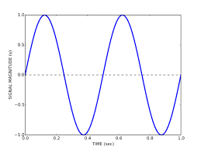
Analog Signals
An analog signal is a continuous electrical signal that varies in strength and frequency over time.
Unlike digital signals, analog signals can take on any value within a range.
Examples - sound waves, voltage fluctuations, and radio waves.

Slide 11
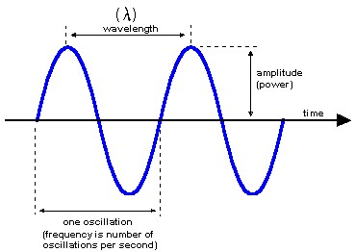
Characteristics of an Analog system

Slide 12

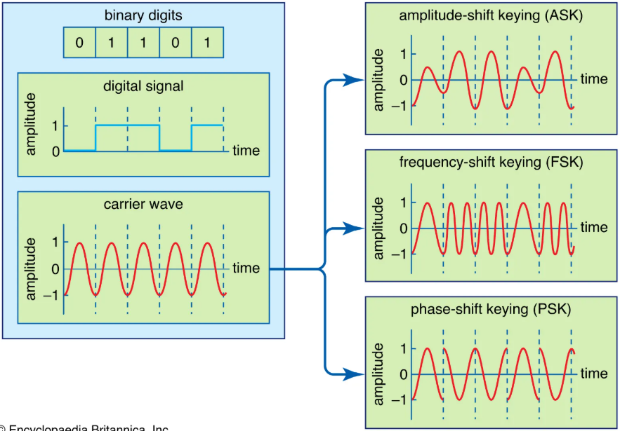
Modulation
Modulation lets us send digital data using analog waves.

Slide 13
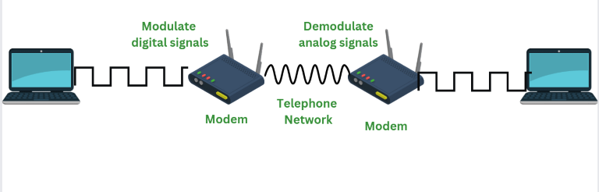
Modem
A modem is a device that connects your home to the internet by translating digital signals from your devices into analog signals that can travel over a network, and vice versa. It acts as a bridge between your local network and your Internet Service Provider (ISP).

Slide 14
Components of Data Communication System

Slide 15
Components of Data Communication System

Slide 16
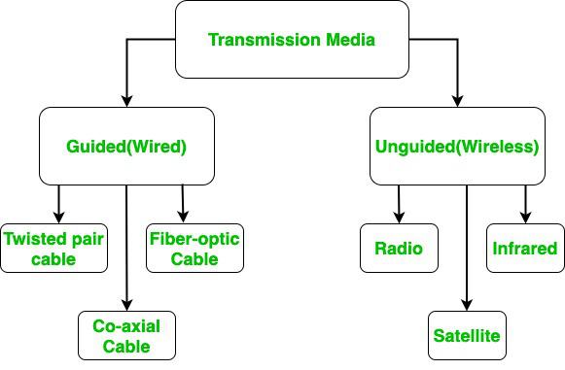
Transmission Media
Transmission media refer to the physical pathways through which data is transmitted from one device to another within a network.

Slide 17
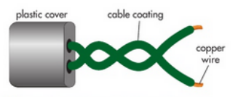
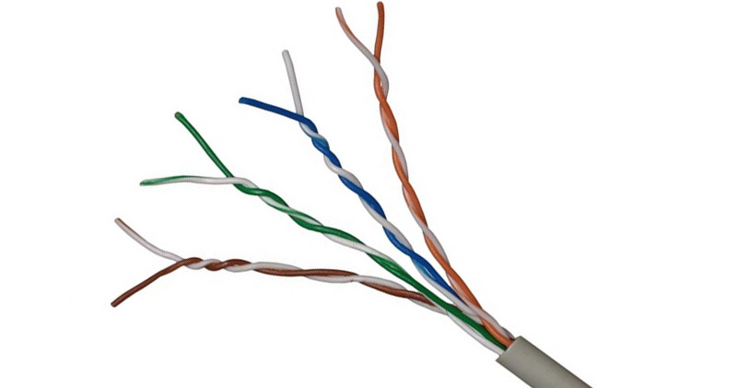
Twisted pair cable
A twisted pair cable is a type of copper cable that has two copper wires. Each copper wire has an insulated layer. The two copper wires are twisted around each other, and there is an outer plastic layer covering them.
Characteristics of twisted pair cables.
They transmit data using electrical currents.
They can transmit data up to a speed of 10 Gbps.
They are cheap to manufacture.
They can suffer from electromagnetic interference, so are only used to carry data over short distances.
They are easy to install.
They are mainly used for telephone communications and for Ethernet connections in a local area network within one building.

Slide 18
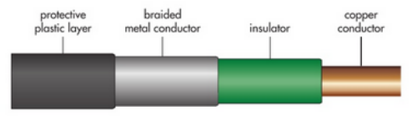
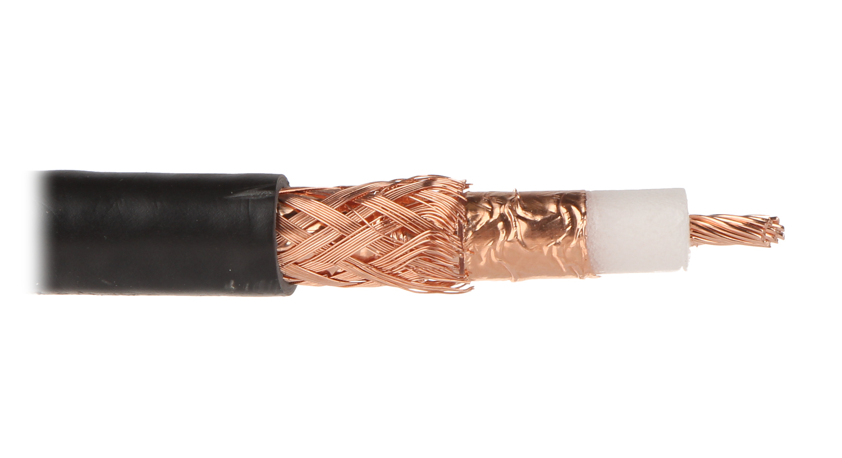
Coaxial cable
A coaxial cable is a type of copper cable. It has a central copper wire that has an insulated layer, a metal conductor layer and a protective plastic outer layer.
Characteristics of coaxial cables.
They transmit data using radio frequency signals.
They can transmit data at speeds of up to 10 Mbps.
They are cheap to manufacture, but not as cheap as twisted pair cables.
They are less prone to electromagnetic interference because of the braided metal conductor layer.
They are difficult to install, as they can be stiff and difficult to bend.
They are mainly used in cable TV connections and sometimes in internet connections.

Slide 19
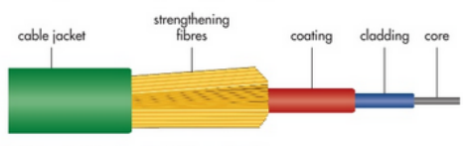
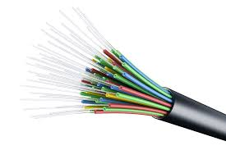
Fiber optic cable
A fiber optic cable has many very thin strands of glass or plastic that make up the core of the cable. The core is covered by a cladding, which is covered by a plastic coating. This plastic coating is covered by strengthening fibers and then an outer coating.
Characteristics of fiber optic cables.
They transmit data using light.
They can transmit data up to speeds of 1 Gbps.
They are expensive to manufacture.
They are not prone to electromagnetic interference.
They are difficult to install, as the cables can be fragile.
They are often used for internet connection and transmitting data over long distances.

Slide 20
Microwaves
A twisted pair cable is a type of copper cable that has two copper wires. Each copper wire has an insulated layer. The two copper wires are twisted around each other, and there is an outer plastic layer covering them.
Characteristics of twisted pair cables.
They transmit data using electrical currents.
They can transmit data up to a speed of 10 Gbps.
They are cheap to manufacture.
They can suffer from electromagnetic interference, so are only used to carry data over short distances.
They are easy to install.
They are mainly used for telephone communications and for Ethernet connections in a local area network within one building.

Slide 21
Radio waves
A twisted pair cable is a type of copper cable that has two copper wires. Each copper wire has an insulated layer. The two copper wires are twisted around each other, and there is an outer plastic layer covering them.
Characteristics of twisted pair cables.
They transmit data using electrical currents.
They can transmit data up to a speed of 10 Gbps.
They are cheap to manufacture.
They can suffer from electromagnetic interference, so are only used to carry data over short distances.
They are easy to install.
They are mainly used for telephone communications and for Ethernet connections in a local area network within one building.

Slide 22
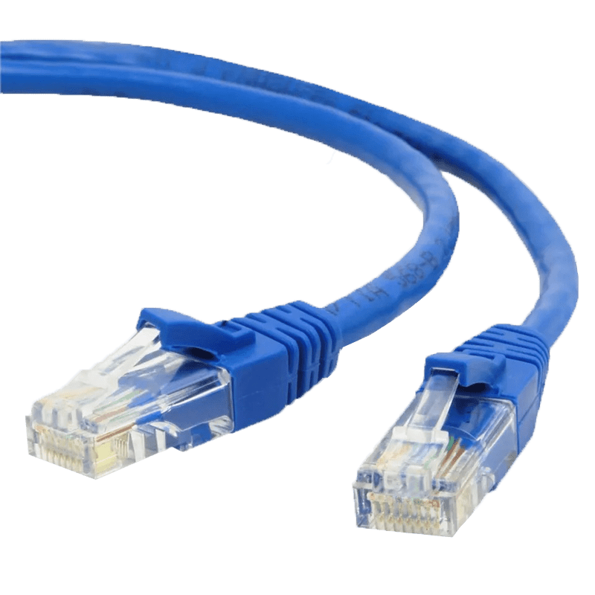
Ethernet
Ethernet is a wired networking technology used to connect computers, printers, routers, and other devices in a local area network (LAN). It (Ethernet protocol) defines how data is formatted, transmitted, and received over physical cables like Cat5e, Cat6, or fiber optic..
Ethernet cables can be coaxial, twisted pair or fiber optic.
LAN – Network that is located within a single building or site

Slide 23
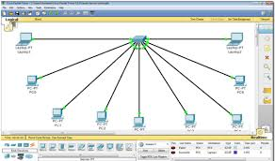
Install Packet Tracer

Slide 24
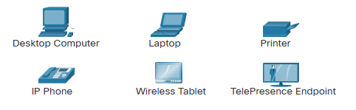
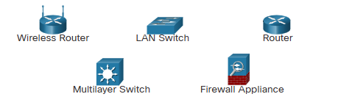
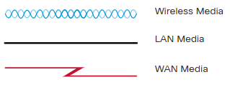
Network Infrastructure
The network infrastructure contains three categories of hardware components.
End devices
Intermediate devices
Network media

Slide 25
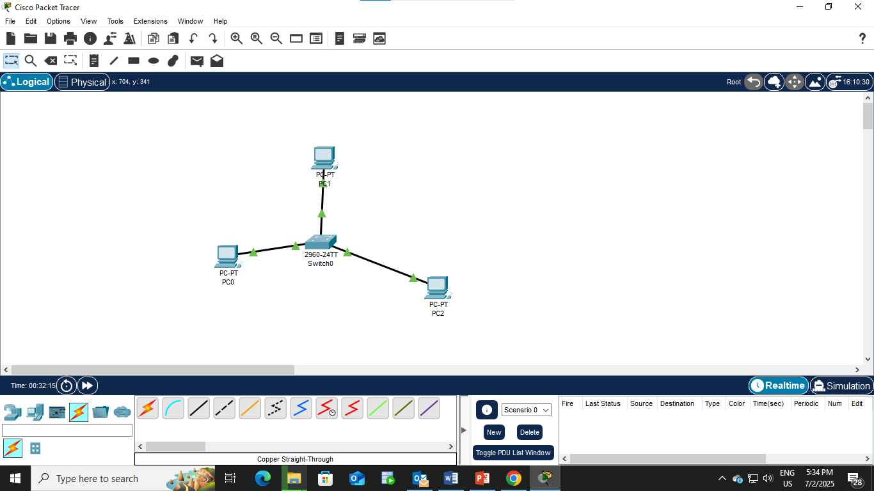

Slide 26
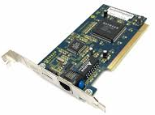
Network Interface Card (NIC)
The main component that any device needs to connect to a network is a network interface card (NIC).
This is a type of circuit board that is built into a device.
NIC allows a device to connect to a network using a wired connection. The wired connection is normally an ethernet connection (RJ-45 port).
A wireless network interface card (WNIC) allows a device to connect to a network using a wireless connection

Slide 27
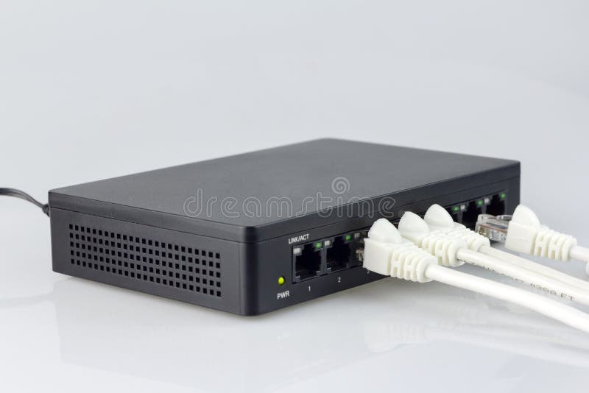
Hub
A hub is the most basic way of connecting several devices in a local area network (LAN).
A hub receives data packets and forwards them on to all devices that are connected to the hub. Only the intended destination device will accept the data sent; the other devices connected to the hub will just ignore it.
Each device is connected to a hub using a wired connection.
The type of wired connection normally used for a hub is either an ethernet connection or a USB connection.
There is a lot of unnecessary traffic in a network where hubs are used. This can cause a lot of data collisions, which can cause errors to occur and reduce the performance of the network.

Slide 28
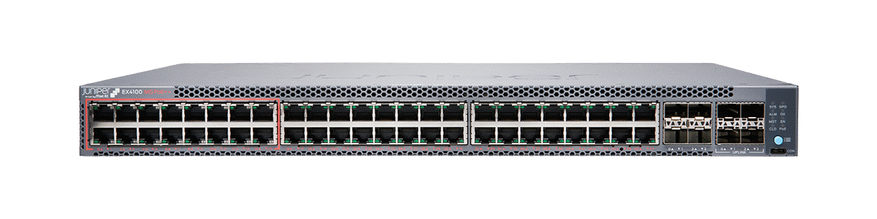
Switch
A switch was developed as an improvement to the inefficiency of a hub. A switch is also used to connect several devices in a LAN network.
Switch, only sends the data packets to the intended destination. It does this by using a device's media access control (MAC) address.
A switch records all the MAC addresses of devices that are attached to it and stores them in a table. It looks at the data packet to find the destination MAC address and forwards the data packet on to this device only.
This reduces the amount of traffic in the network and as a result reduces the number of data collisions. This improves the performance of the network.

Slide 30
MAC Address
A MAC address can be used to identify a device in a network. The MAC address is assigned by the manufacturer of the device when it is being made. The MAC address is given to the NIC that is built into the device
Features of a MAC address:
Each address is unique.
It is written in hexadecimal.
It has 12 digits and the digits are grouped in pairs.
Each pair of digits is separated by a colon.
The first three pairs of digits are the manufacturer's ID.
The second three pairs are the serial number of the device.
Example - 3C:5A:B4:01:63:D2
Used in a LAN when data is sent from one device to another within the LAN

Slide 31
IP Address
An IP address (Internet Protocol Address) is a unique numerical identifier assigned to each device connected to a network that uses the Internet Protocol for communication.
IP address is use to uniquely identify a device on the network and to determine where the device is located in the network, so data can be sent to and from it.
IPV4 – 192.168.1.1
IPV6 - 2001:0db8:85a3:0000:0000:8a2e:0370:7334
The sender includes the destination IP address in the data packet. Routers use this IP address to forward the packet to the correct destination.

Slide 32
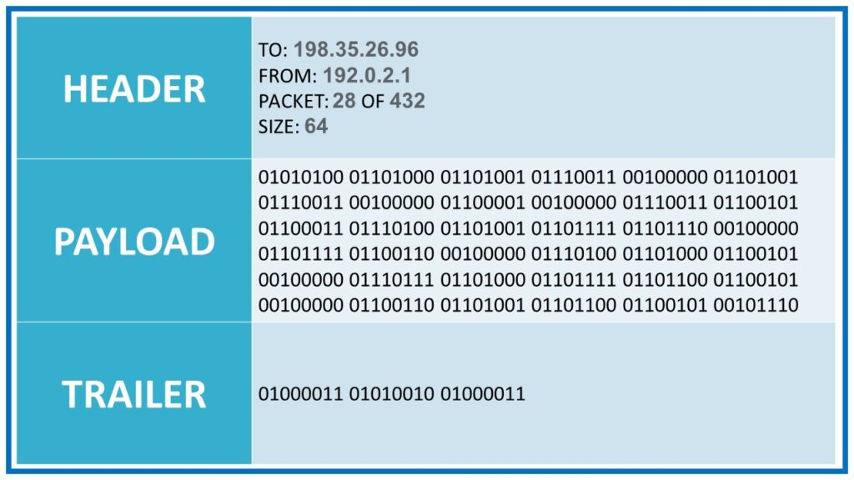
Data Packet
The unit of data that contains the information to be transmitted across a network

Slide 33
Types of Computer Networks
An IP address (Internet Protocol Address) is a unique numerical identifier assigned to each device connected to a network that uses the Internet Protocol for communication.
IP address is use to uniquely identify a device on the network and to determine where the device is located in the network, so data can be sent to and from it.
IPV4 – 192.168.1.1
IPV6 - 2001:0db8:85a3:0000:0000:8a2e:0370:7334
The sender includes the destination IP address in the data packet. Routers use this IP address to forward the packet to the correct destination.

Slide 34
Types of Computer Networks
An IP address (Internet Protocol Address) is a unique numerical identifier assigned to each device connected to a network that uses the Internet Protocol for communication.
IP address is use to uniquely identify a device on the network and to determine where the device is located in the network, so data can be sent to and from it.
IPV4 – 192.168.1.1
IPV6 - 2001:0db8:85a3:0000:0000:8a2e:0370:7334
The sender includes the destination IP address in the data packet. Routers use this IP address to forward the packet to the correct destination.

Slide 35
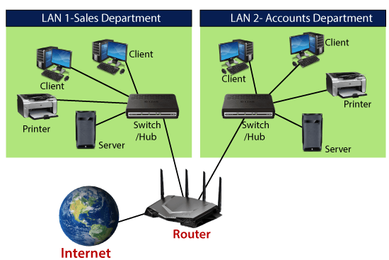
Router
A router is a device that connects different networks and forwards data based on IP addresses. In homes, it acts as a gateway between your LAN and the internet.
Switches and hubs are used to build and expand a LAN. A router is used to connect one LAN to another network, such as the Internet or another LAN.

